Slide 1
TRIALS, TRIBULATIONS, AND TRIUMPHS OF TREATING TRAUMA
DEBORAH S. BLALOCK
DEPUTY DIRECTOR
COMMUNITY MENTAL HEALTH SERVICES
SCDMH
DEBORAH.BLALOCK@SCDMH.ORG
FEBRUARY 14, 2020

Slide 2
TRAUMA….WHAT IS IT?
DSM-5 defines a traumatic event as exposure to death, threatened death, actual or threatened serious injury, or actual or threatened sexual violence.
Emotional trauma, or psychological trauma, is the physical and emotional response that may occur after a person experiences extremely stressful or traumatic events. Although traumatic experiences frequently involve a threat to your life or security, these events can be both physical and psychological, either directly or indirectly experienced.
Reference: www.sharecare.com/health/depression/what-is-emotional-trauma

Slide 3
ACES – ADVERSE CHILDHOOD EXPERIENCES
Adverse childhood experiences, or ACEs, are potentially traumatic events that occur in childhood (0-17 years). For example:
experiencing violence or abuse
witnessing violence in the home or community
having a family member attempt or die by suicide
Also included are aspects of the child’s environment that can undermine their sense of safety, stability, and bonding such as growing up in a household with:
substance misuse
mental health problems
instability due to parental separation or household members being in jail or prison
ACEs are linked to chronic health problems, mental illness, and substance misuse in adulthood. ACEs can also negatively impact education and job opportunities. However, ACEs can be prevented.
61% of adults reported having experienced at least one type of ACE. (CDC)

Slide 4
DSM-5 CRITERIA FOR PTSD (National Center for PTSD, U.S. Department of Veterans Affairs, 7%-8% of population)
Criterion A: stressor (one required)
The person was exposed to: death, threatened death, actual or threatened serious injury, or actual or threatened sexual violence, in the following way(s):
Direct exposure
Witnessing the trauma
Learning that a relative or close friend was exposed to a trauma
Indirect exposure to aversive details of the trauma, usually in the course of professional duties (e.g., first responders, medics)
Criterion B: intrusion symptoms (one required)
The traumatic event is persistently re-experienced in the following way(s):
Unwanted upsetting memories
Nightmares
Flashbacks
Emotional distress after exposure to traumatic reminders
Physical reactivity after exposure to traumatic reminders

Slide 5
DSM-5 CRITERIA FOR PTSD (National Center for PTSD, U.S. Department of Veterans Affairs)
Criterion C: avoidance (one required)
Avoidance of trauma-related stimuli after the trauma, in the following way(s):
Trauma-related thoughts or feelings
Trauma-related external reminders
Criterion D: negative alterations in cognitions and mood (two required)
Negative thoughts or feelings that began or worsened after the trauma, in the following way(s):
Inability to recall key features of the trauma
Overly negative thoughts and assumptions about oneself or the world
Exaggerated blame of self or others for causing the trauma
Negative affect
Decreased interest in activities
Feeling isolated
Difficulty experiencing positive affect
Symptoms are not due to medication, substance use, or other illness.

Slide 6
DSM-5 CRITERIA FOR PTSD (National Center for PTSD, U.S. Department of Veterans Affairs)
Criterion E: alterations in arousal and reactivity
Trauma-related arousal and reactivity that began or worsened after the trauma,
in the following way(s):
Irritability or aggression
Risky or destructive behavior
Hypervigilance
Heightened startle reaction
Difficulty concentrating
Difficulty sleeping
Criterion F: duration (required)
Symptoms last for more than 1 month.
Criterion G: functional significance (required)
Symptoms create distress or functional impairment (e.g., social, occupational).
Criterion H: exclusion (required)

Slide 7
EVIDENCED BASED TREATMENTS (EBTs) FOR TRAUMA OFFERED BY SCDMH
PROLONGED EXPOSURE (PE) – 8-15 sessions of gradual imaginal repeated retelling of the memory and gradual in-vivo exposure to feelings and situations
COGNITIVE PROCESSING THERAPY (CPT) – 12 weeks; teaches one how to change thoughts and subsequently feeling and behaviors
EYE MOVEMENT REPROCESSING AND DESENSITIZATION (EMDR) – 1-10 sessions of imaginal recall with therapeutic direction and provision of bilateral sensory input
TRAUMA FOCUSED COGNITIVE BEHAVIORAL THERAPY (TFCBT) – 12-25 sessions divided equally between youth and caregiver to provide psychoeducation, parenting skills, relaxation skills, affective modulation, cognitive coping, trauma narrative, in-vivo recall, safety enhancing skills

Slide 8




SCDMH - A TRUE SYSTEM OF CARE
(A BRIEF OVERVIEW)
TARGET POPULATION APPROPRIATE STRATEGY
SCHOOLS, PTAS, CHURCHES, FIRST STEPS, BUSINESSES, FIRST RESPONDERS, CIVIC CLUBS, GENERAL PUBLIC AT FESTIVALS, FAIRS, MARKETS, ETC.
PREVENTION – INFANT & EARLY CHILDHOOD CARE,
SCHOOL MENTAL HEALTH, ANTI-STIGMA CAMPAIGNS, CIT*,
MENTAL HEALTH FIRST AID, SUICIDE PREVENTION,
STAKEHOLDER MEETINGS, FARMACY TEAMS, ETC.
*Crisis Intervention Team Training
PATIENTS WITH MILD/MODERATE SYMPTOMS; PATIENTS WITH STABLE CHRONIC SYMPTOMS, BUT IN NEED OF ONGOING CARE, ETC.
IMMEDIATE ACCESS TO EVIDENCED BASED TX & PROGRAMS* VIA WALK-IN CLINICS, EXTENDED HOURS,TELEPYSCH. INTEGRATED CARE, CARE COORDINATION, PEER SUPPORT, MED. MGT.,
*CBT, DBT, EMDR, PCIT, TFCBT, MI, IPS, etc.
PATIENTS WITH ACUTE SYMPTOMS OR SIGNIFICANT, UNSTABLE CHRONIC SYMPTOMS
ABOVE; PLUS ICT, MDFT, FEP, FRST*, HOMELESS OUTREACH, CO-OCCURRING TX, ETC.
*ICT – Intensive Community Treatment
MDFT- Multidimensional Family Therapy
FEP – First Episode Psychosis
FRST – First Responder Support Teams
PATIENTS WITH EXACERBATION OF SYMPTOMS & IN CRISIS
ABOVE: PLUS CSUs, CCRI, LE & DJJ* EMBEDDED MHPS, EMS TELEPSYCH, ETC.
*CSU – Crisis Stabilization Unit
CCRI – Community Crisis Response & Intervention
LE – Law Enforcement
DJJ – Department Of Juvenile Justice
TARGET:
Right Treatment At The Right Time In The Right Place By The Right Provider - Preventing Avoidable Emergency Department (ED) Visits, Hospitalizations, and Incarcerations
PATIENTS IN AN ED OR JAIL
MENTAL HEALTH COURTS, MHPS IN EDS & JAILS
Cost-sharing Positions, Liaisons, etc.
DANGER TO SELF/ OTHERS
INPATIENT CARE
Best Pharmacological Practices, DBT, Learning Labs, Transition Specialists, Peer Support, etc.
Deborah S. Blalock, 2019

Slide 9
SCDMH/CRIMINAL JUSTICE SYSTEM INTERCEPT MAP
Statewide crisis line – 833-DMH-CCRI
Statewide 24/7 Community Crisis Response and Intervention (CCRI)
School Mental Health
Street Medicine Teams
Mental Health First Aid
Crisis Intervention Team (CIT) Training
Intensive Community Services
Homeless Outreach
CCRI
EMS/MHC telehealth
LE/MHC telehealth
MHP in consolidated dispatch
First Responder Support Teams
SCLEAP support
SCDMH JIP Program Director
Mental Health Task Forces
CJCC participation
MHPs embedded in LEA
MHPs embedded in detention centers
Designated Examiners
Forensic Evaluations
Restoration Services
Forensic Inpatient Services
Detention Center Liaisons
DJJ MOA, Liaison
Mental Health Courts
Drug Courts
Veterans’ Courts
Homeless Courts
Juvenile Mental Health Courts
Sharing records w/SCDC
SOAR project
SVP Program
Opportunity to improve data sharing perhaps with SCEIX
Released inmates offered immediate appointment with MHC
MOA with PPP
MHP embedded with PPP
Care Coordination
CPSS staff
Opportunity to create warm handoff when being released – exploring EBPs to determine most effective in engaging patient in treatment

Slide 10
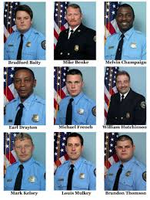
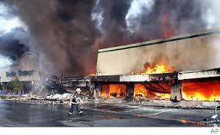
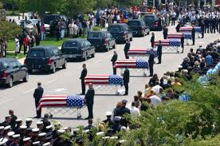
SOFA SUPER STORE FIRE AND THE CHARLESTON 9 JUNE 18, 2007

Slide 11


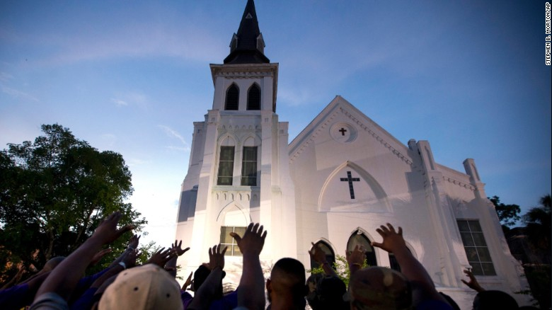
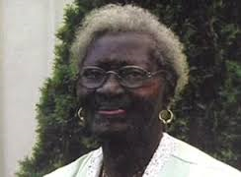






MOTHER EMANUEL MASSACRE & THE EMANUEL 9 – JUNE 17, 2015
Sharonda Coleman-Singleton
Twanza Sanders
Susie Jackson
Rev. Senator Clementa Pinckney
Myra Thompson
Ethel Lance
Cynthia Hurd
Rev. Depayne Middleton Doctor
Rev. Daniel Simmons

Slide 12

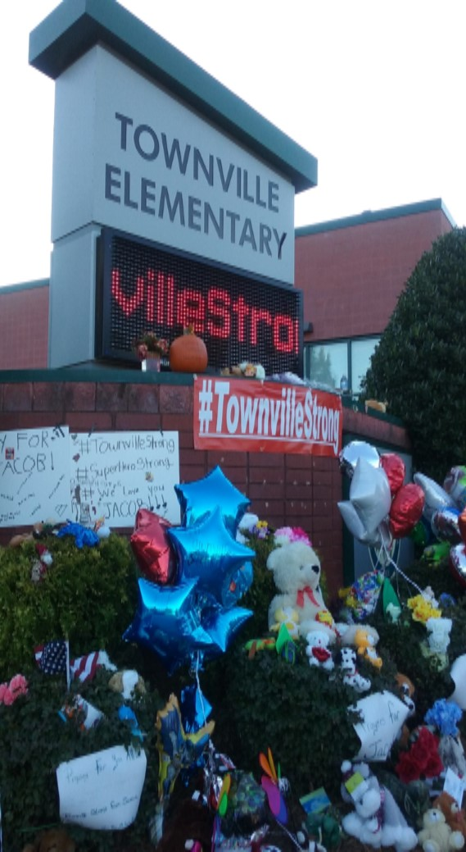
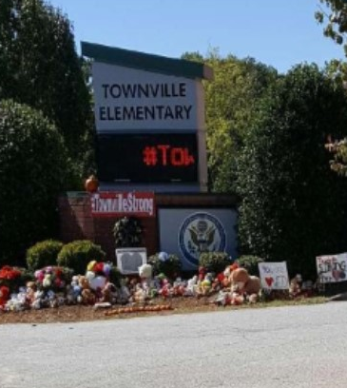
SHOOTING AT TOWNVILLE ELEMENTARY SCHOOL SEPTEMBER 28, 2016
Jacob Hall

Slide 13

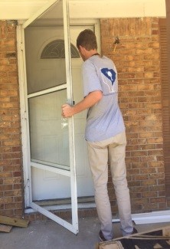
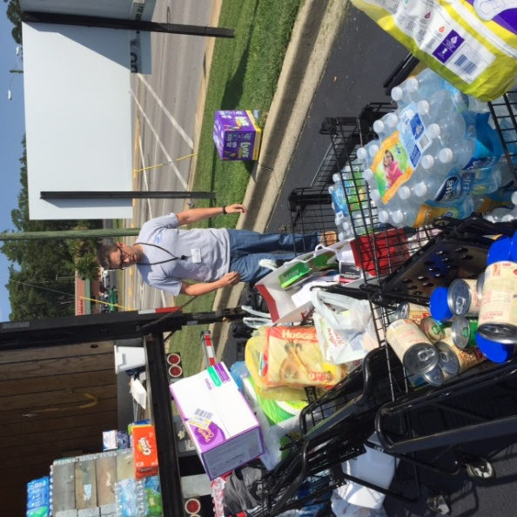
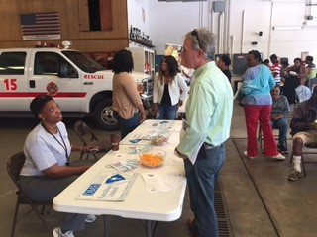
HISTORIC SC FLOODS 2015 AND 2018

Slide 14
LESSONS LEARNED FROM RESPONDING TO MULTIPLE TRAUMATC EVENTS - MASS AND INDIVIDUAL
Creating relationships & trust before the crisis
The need for systems’ flexibility
Dealing with federal and local assistance
Ego management…..
Natural vs. Manmade disaster – unique challenges
Dealing with confounding issues, like hate, prejudices, etc. Straight out the gate
Recognizing all losses - when a sanctuary is no longer a sanctuary, privacy, identity, community, safety
Ensuring cultural sensitivity – religious, spirituality vs. Psychology, race, gender, ethnicity, generational, etc.
Asking about needs, not assuming, and addressing all

Slide 15
MORE LESSONS
Delivering care where & when it is needed – ensure immediate access
Willingness to shift strategies along the way
The right staff for the job – not all who wish to volunteer should
Making sure staff have right skill sets and training
Patience and persistence may pay off
Must care for care-givers – asking for help
Once you’re in it, you’re in it for the long haul
Being mindful of the number of anniversary/commemoration events and the emotional toll on these important dates
Court cases may takes a toll on an entire community
The power of presence

Slide 16


RECOGNIZE AND NOURISH RESILENCE!

